Slide 1
GEOG788P First Project Update
Natalie Memarsadeghi

Slide 2
Overview
Objectives
Background
Methods
Anticipated Challenges

Slide 3
Objectives
Calculate runoff extent during a rainfall event in upstate New York
Create a time lapse visualization displaying runoff extent
Perform statistical analysis
Local Moran’s I of rain gauges in NY

Slide 4
Background: Why is flood mapping important?
Identify high risk areas and evacuation needs
Assess at risk infrastructure and economic impacts of flooding
Natural stormwater management
Determining insurance rates and premiums for homeowners
The methodology of my project could be modified and applied at any location

Slide 5
Methods: Study Area
Site: Oatka Creek at Warsaw NY (drainage basin area = 39.5 square miles)
Water type: Stream
Time Period: 12pm October 3rd- 12am 5th, 2021
Cumulative Precipitation: Approximately 1.4 inches
Data Source: USGS Water Watch

Slide 6
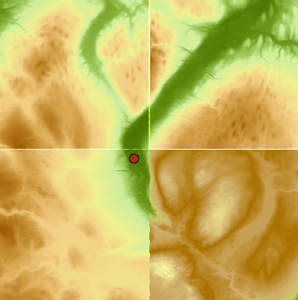
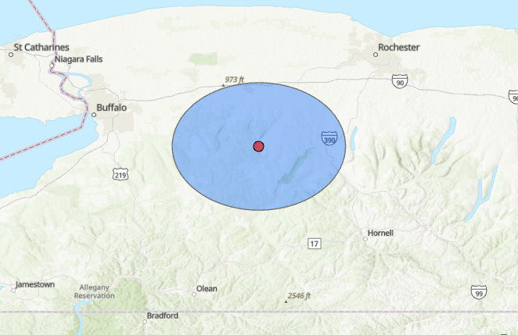

Slide 7
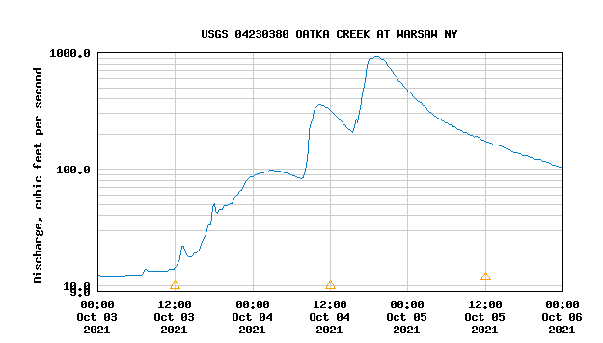
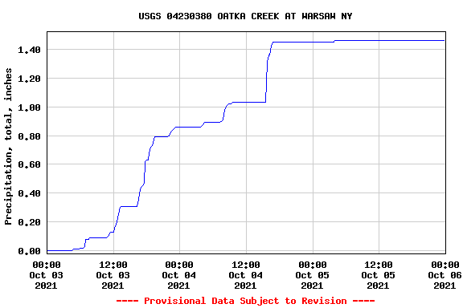

Slide 8
Methods: Runoff Volume and Velocity
Obtain precipitation, baseflow, and discharge values for rain event (provided in 15 minute intervals)
Calculate runoff volume (cubic feet)
Current (during rain event) discharge - baseflow (discharge from before rain event)
Convert to correct time interval (15 minutes)
Calculate runoff velocity
Using the rational method
Q = ciA
Where Q is runoff velocity (cfs), c is rational runoff coefficient (determined by land surface type), i is average rainfall intensity (in/hr), and A is drainage basin area
Convert to correct time interval (15 minutes)
Notes:
Mention assumptions and how a different method would be needed for larger drainage basins

Slide 9
Methods
These calculations will result in:
Total volume of runoff (cubic feet)
Rate of runoff (cfs converted to cubic feet/ 15 minutes)
Next:
Use these values to calculate distance traveled by water

Slide 10
Methods: Data visualization
geopandas and matplotlib
Rainfall event was 36 hours long
144 different scenes

Slide 11
Methods: Statistical Analysis
Local Moran’s I of all rain gauges of NY state
Determine if there is correlation between the locations of rain gauges
Are there areas with significantly more rain gauges?
This would likely indicate were the most monitoring is needed

Slide 12
Anticipated Challenges
Determining how slope influences the direction of runoff
We will know how much runoff there is and how fast it is moving, but this does not tell us where it is moving
We can not assume that the water is moving uniformly due to the slope
Data is coming from a single rain gauge at one location
Aim is to add a coefficient in runoff velocity that accounts for the slope
Creating 144 different scenes
This could be very timely because of how many different scenes are necessary
Aim is to automate this process in a loop

